Slide 1





Smart AgroConnect
S. K. Patel Institute of Management and Computer Studies-MCA
A Constituent College of Kadi Sarva Vishwavidyalaya, Gandhinagar.
Event Under MMPSRC – KSV : Internal Odoo Hackathon – 2025
Duration : 01/03/2025 Time: 09:00 AM Onwards
Tech Titans
No | Enrollment No | Name of Members
1 | 24MCA02019 | Dave Vaidhehi P.
2 | 24MCA02037 | Korat Vyom R.
3 | 24MCA02041 | Ladola Priya D.
4 | 24MCA02115 | Somani Parv S.

Slide 2
Contents
1
2
3
4
Introduction to Smart AgroConnect
Our Solution – Smart AgroConnect
Competitor Comparison
Problem Statement
5
6
7
Business & Revenue Model
Conclusion & Next Steps
Technology Stack

Slide 3
Introduction to Smart AgroConnect
1
/

Slide 4
Bridging Farmers & Buyers
A Fair & Transparent Trade Solution
Buyers Face Trust Issues
Smart AgroConnect connects farmers and buyers directly, eliminating middlemen to build trust and reduce costs for both parties.
Buyers struggle to verify if farm products are genuine and of good quality.
Without trust, buyers hesitate to purchase, affecting their business.
Farmers Lose Money to Middlemen
Farmers lose 40-50% of their income because middlemen take a big share of their earnings.
A direct selling platform can help farmers make more profit.

Slide 5


Visual Representation
Agriculture Background
Farmer Selling Produce
A bright background with green fields and crops represents farming, creating a friendly and suitable setting for presenting Smart AgroConnect.
An image of a farmer selling fresh produce directly to a buyer clearly represents the direct trade model, showing a marketplace where deals happen without middlemen.

Slide 6
Problem Statement
2
/

Slide 7
Challenges in Agriculture Trade
Lack of Transparency in Transactions
Inefficient Delivery Logistics
Buyers often have trouble finding clear and reliable information about sellers, causing mistrust and hesitation. Without verified seller details, the marketplace becomes uncertain.
The agricultural supply chain is inefficient because farmers can't track deliveries in real-time. This leads to a poor customer experience, as buyers don't get timely updates on their shipments.
01
02
03
04
Middlemen Exploitation
Unfair Pricing Issues
The problem of middlemen taking advantage of farmers causes them to get unfair prices for their crops, creating financial difficulties in rural communities that depend on farming.
Farmers often don’t have real-time market data to set fair prices. This can lead them to sell their products too cheaply, reducing their profits.

Slide 8
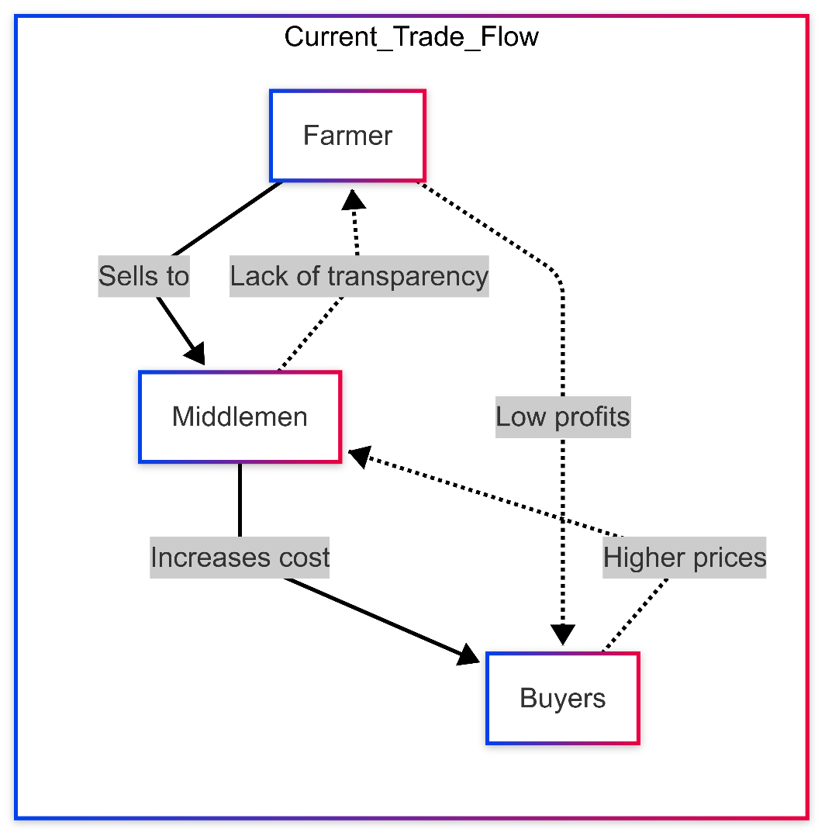
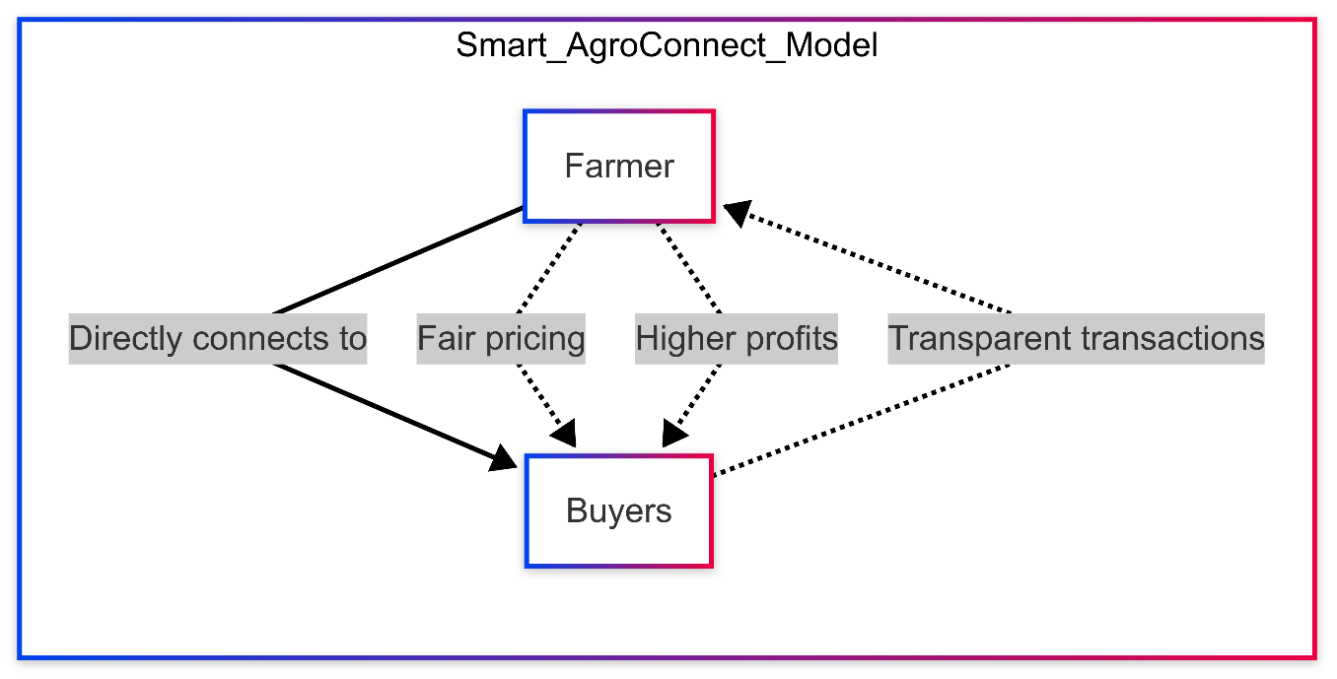
Visual Information

Slide 9
Our Solution – Smart AgroConnect
3
/

Slide 10
Key Features of Smart AgroConnect
1
3
2
Direct Trade Model
AI-Powered Price Prediction
Certified Transactions System
Smart AgroConnect connects farmers and buyers directly, ensuring fair prices and better profits for farmers. This approach builds a strong community and supports sustainable farming.
Smart AgroConnect uses artificial intelligence to predict market prices based on various factors, helping farmers get better offers. This enables them to make smart decisions and maximize their earnings.
The platform has a certification system for farmers and buyers to verify transactions. This builds trust and protects both sides, making trade safer and more reliable.

Slide 11
Logistics and Payment Solutions
Secure Blockchain Payments
By utilizing blockchain technology, Smart AgroConnect offers secure and transparent payment options that protect against fraud and ensure that payments are released only upon delivery confirmation, thereby enhancing trust.
GPS-Based Real-Time Tracking
The integration of GPS technology into the logistics process allows users to track shipments in real-time, providing buyers with delivery updates and elevating customer satisfaction from a seamless transaction experience.

Slide 12
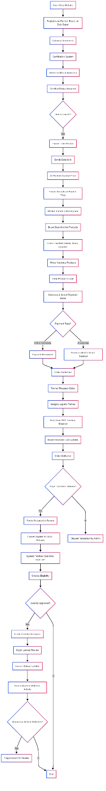
Flowchart of Market Interaction

Slide 13
Competitor Comparison
4
/

Slide 14


Visual Diagram
Feature | Ninjacart INDIA | AgriBazzar INDIA | Ripe.io USA | Smart AgroConnect INDIA(OUR)
Core Focus | B2B Agri-Supply Chain | Digital Marketplace | Blockchain for Food Transparency | AI-Driven Direct Farmer-to-Buyer Marketplace
AI-Based Price Prediction
Blockchain for Transactions
Direct Farmer-to-Buyer Sales
Logistics & GPS Tracking
Certified Farmer & Buyer System

Slide 15
Technology Stack
5
/

Slide 16

Frontend and Backend Technologies
Frontend Development Tools
Utilizing modern frameworks like React.js, Tailwind CSS, and Redux ensures a responsive and user-friendly interface, making navigation intuitive for users of all technical backgrounds.
Backend Frameworks
The backend is powered by Node.js and Express.js, along with MongoDB for data storage, ensuring robust performance and high scalability in handling user transactions and data.

Slide 17
AI and Payment Solutions
AI Tools and Models
Payment Gateways
The platform employs AI models developed with Python, TensorFlow, and Scikit-Learn, which are capable of analyzing vast data sets to generate meaningful insights on pricing and demand predictions.
Integration with payment gateways such as Razorpay and Stripe, alongside blockchain capabilities, provides users with flexible and secure transaction options, catering to both traditional and modern payment methods.
01
02

Slide 18
Security Mechanisms
Authentication Protocols
Data Security Measures
Security is a top priority, using authentication methods like JWT and Firebase/Auth0 to protect user identities and ensure that only authorized users access important features.
Robust security measures, such as encryption and industry-standard compliance, protect user information and transactions, ensuring a safe trading environment.

Slide 19
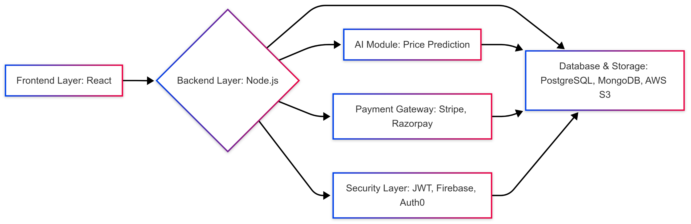
Visual Diagram

Slide 20
Business & Revenue Model
6
/

Slide 21

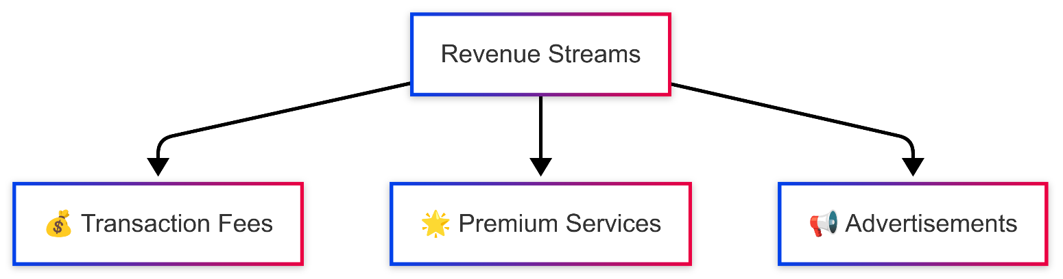
Visual Representation
Icons and Revenue Streams Diagram

Slide 22
Revenue Streams
Transaction Fees
Freemium and Premium Models
Advertisements and Partnerships
The business model incorporates a transaction fee structure, typically between 2-5% per order, allowing the platform to generate sustainable revenue while keeping costs manageable for users.
Smart AgroConnect offers a freemium model where basic features are accessible for free, while premium features and bulk purchasing options are available for a fee, accommodating a variety of user needs.
The platform may also monetize through relevant advertisements from agricultural brands and service providers, creating additional revenue streams while providing value to users through curated offers.

Slide 23
Future Growth Opportunities
Demand Forecasting
Future improvements may include advanced AI-driven demand forecasting functionalities that help farmers plan crop production based on market trends, maximizing their revenue and minimizing waste.
Global Market Expansion
As the platform matures, there are opportunities to expand globally, connecting farmers in different regions and introducing functionality tailored to diverse agricultural practices and market conditions.

Slide 24
Conclusion & Next Steps
7
/

Slide 25
Roadmap to Launch
MVP Development Phase
AI Integration Phase
Blockchain Expansion Phase
International Market Scaling
The first step is to build a basic version of the product (MVP) with essential features for buying and selling, making payments, and handling deliveries.
In the next phase, AI will be used to improve price predictions and make the platform smarter and easier to use for everyone.
In the third phase, blockchain will be used to make transactions safer and more reliable, improving the overall system.
In the final phase, the platform will expand globally, adjusting to different markets and regulations to build a worldwide agricultural marketplace.

Slide 26
Future Vision
Transparent and Profitable Solutions
The goal of Smart AgroConnect is to support farmers and buyers with a fair and transparent trading platform, ensuring farmers earn well while buyers get genuine products.
Enhanced Trust in Agriculture Transactions
Smart AgroConnect uses technology to offer reliable, efficient, and easy-to-use services, building trust in agricultural transactions and improving the entire farming industry.

Slide 27
Thank you for watching.

